Slide 1
Actor Critic

Slide 2
Outline
Recap on Policy-based Methods
Introduction

Slide 3
Recap on Policy-based Methods
In Policy-Based methods, we aim to optimize the policy directly without using a value function.
More precisely, Reinforce is part of a subclass of Policy-Based Methods called Policy-Gradient methods.
This subclass optimizes the policy directly by estimating the weights of the optimal policy using Gradient Ascent.

Slide 4
Recap on Policy-based Methods
We saw that Reinforce worked well.
However, because we use Monte-Carlo sampling to estimate return (we use an entire episode to calculate the return), we have significant variance in policy gradient estimation

Slide 5
Recap on Policy-based Methods
Remember that the policy gradient estimation is the direction of the steepest increase in return.
In other words, how to update our policy weights so that actions that lead to good returns have a higher probability of being taken.
The Monte Carlo variance, which we will further study in this unit, leads to slower training since we need a lot of samples to mitigate it.

Slide 6
We will study Actor-Critic methods, a hybrid architecture combining value-based and Policy-Based methods that helps to stabilize the training by reducing the variance using:
An Actor that controls how our agent behaves (Policy-Based method)
A Critic that measures how good the taken action is (Value-Based method)

Slide 7
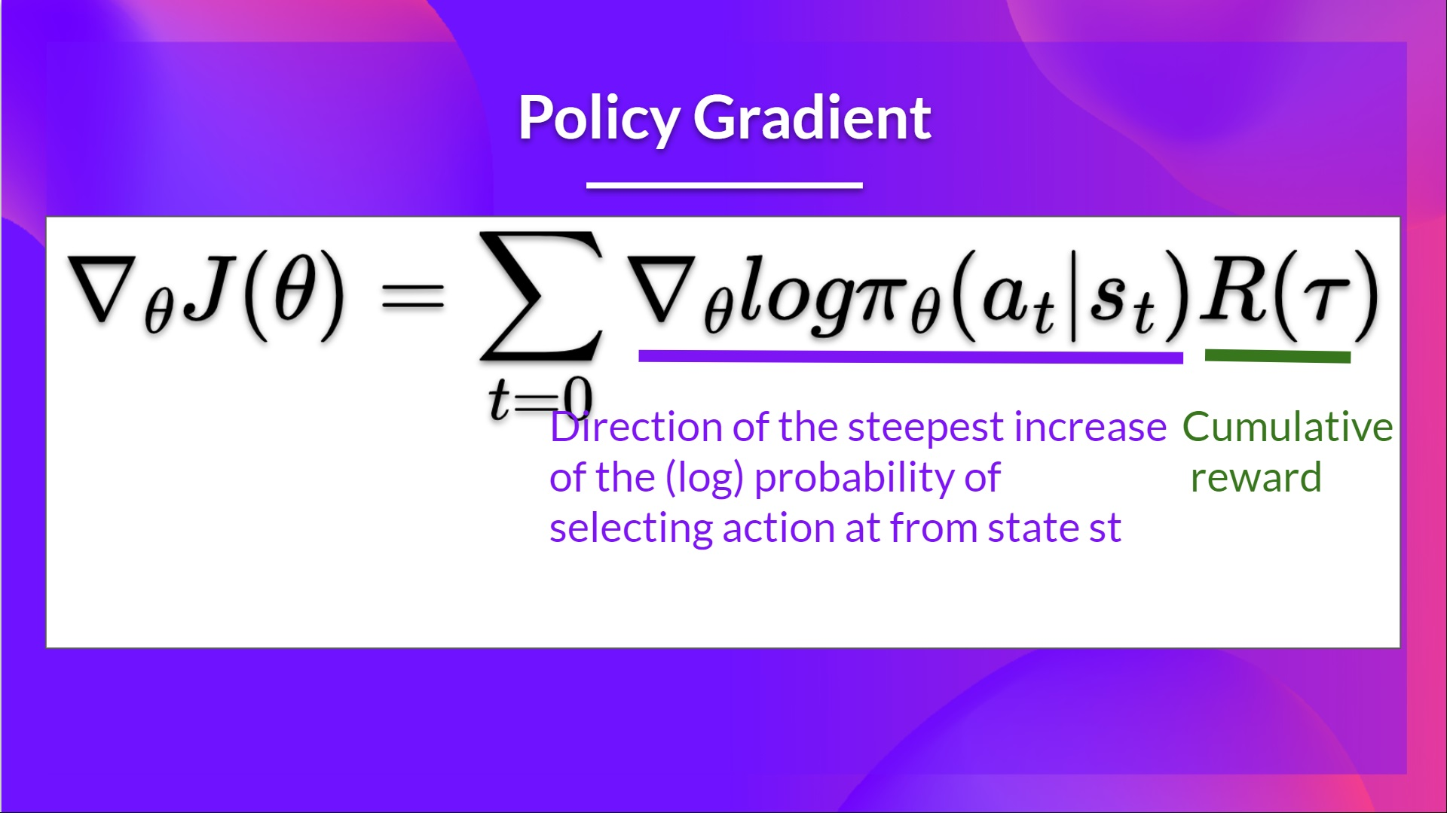
The Problem of Variance in Reinforce
In Reinforce, we want to increase the probability of actions in a trajectory proportionally to how high the return is.

Slide 8
The Problem of Variance in Reinforce
If the return is high, we will push up the probabilities of the (state, action) combinations.
Otherwise, if the return is low, it will push down the probabilities of the (state, action) combinations.

Slide 9
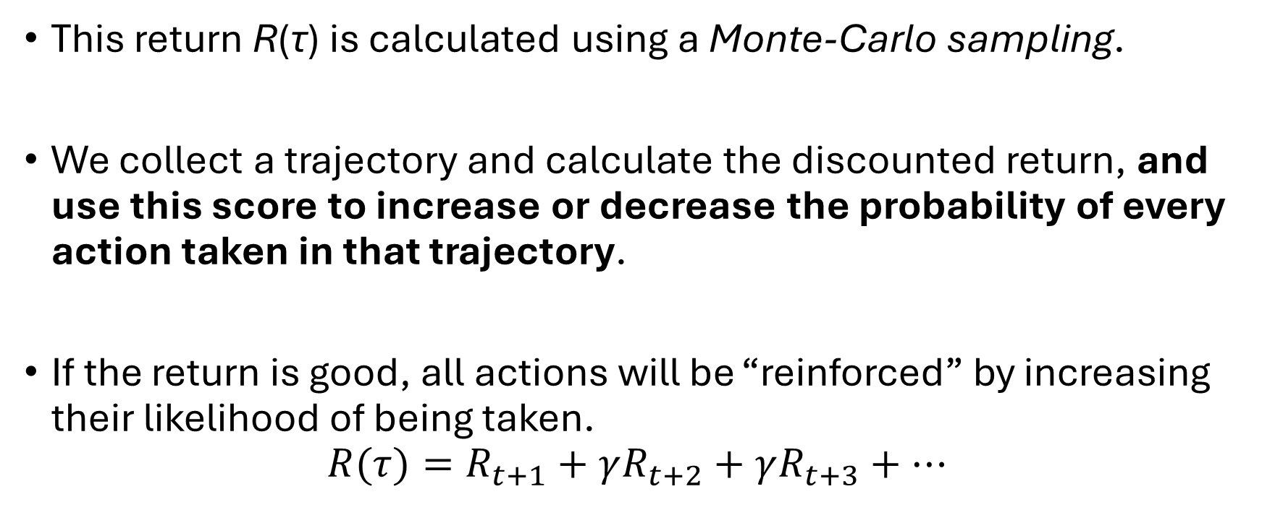
The Problem of Variance in Reinforce
This return R(τ) is calculated using a Monte-Carlo sampling.
We collect a trajectory and calculate the discounted return, and use this score to increase or decrease the probability of every action taken in that trajectory.
If the return is good, all actions will be “reinforced” by increasing their likelihood of being taken.
$$R(τ)=R_{t+1}​+γR_{t+2}​+γR_{t+3}​+…$$

Slide 10
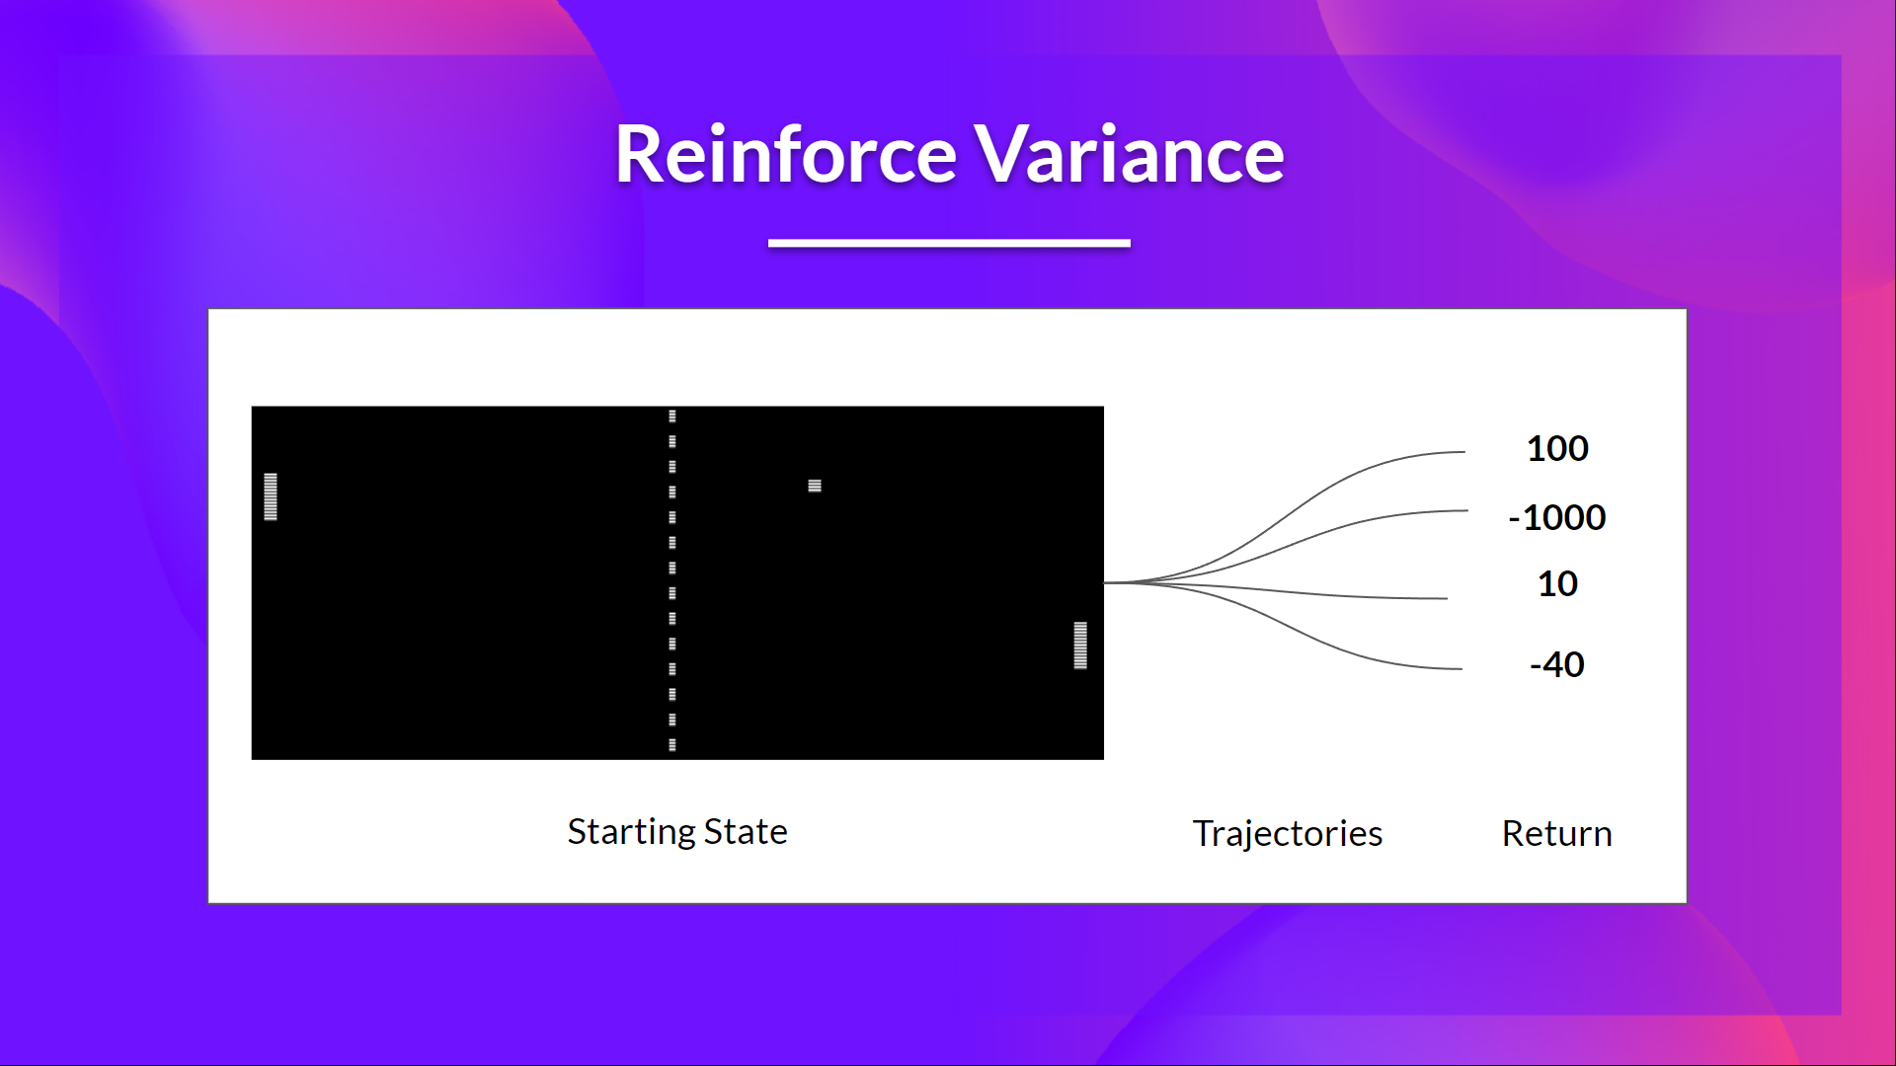
The Problem of Variance in Reinforce
The advantage of this method is that it’s unbiased. Since we’re not estimating the return, we use only the true return we obtain.

Slide 11
The Problem of Variance in Reinforce
Given the stochasticity of the environment (random events during an episode) and stochasticity of the policy, trajectories can lead to different returns, which can lead to high variance.
Consequently, the same starting state can lead to very different returns. Because of this, the return starting at the same state can vary significantly across episodes.

Slide 12
The Problem of Variance in Reinforce
However, increasing the batch size significantly reduces sample efficiency. So we need to find additional mechanisms to reduce the variance.

Slide 13
The Problem of Variance in Reinforce
The solution is to mitigate the variance by using a large number of trajectories, hoping that the variance introduced in any one trajectory will be reduced in aggregate and provide a “true” estimation of the return.

Slide 14
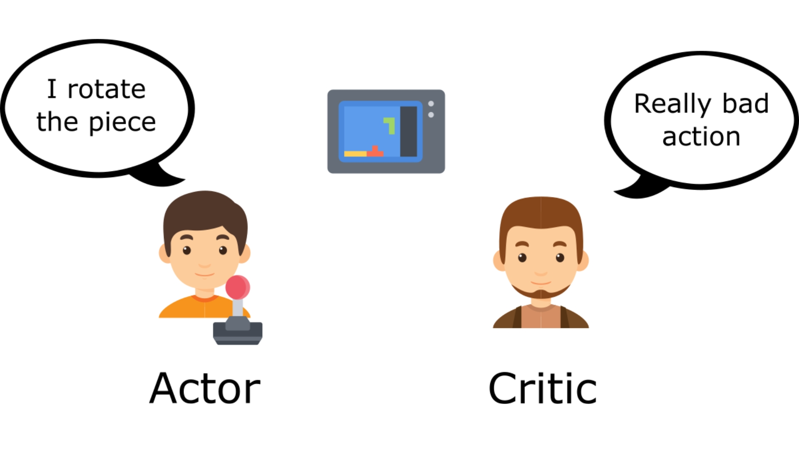
Reducing variance with Actor-Critic methods
The solution to reducing the variance of the Reinforce algorithm and training our agent faster and better is to use a combination of Policy-Based and Value-Based methods: the Actor-Critic method.

Slide 15
Reducing variance with Actor-Critic methods
To understand the Actor-Critic, imagine you’re playing a video game.
You can play with a friend that will provide you with some feedback.
You’re the Actor and your friend is the Critic.

Slide 16
Reducing variance with Actor-Critic methods
You don’t know how to play at the beginning, so you try some actions randomly. The Critic observes your action and provides feedback.
Learning from this feedback, you’ll update your policy and be better at playing that game.

Slide 17
Reducing variance with Actor-Critic methods
On the other hand, your friend (Critic) will also update their way to provide feedback so it can be better next time.

Slide 18
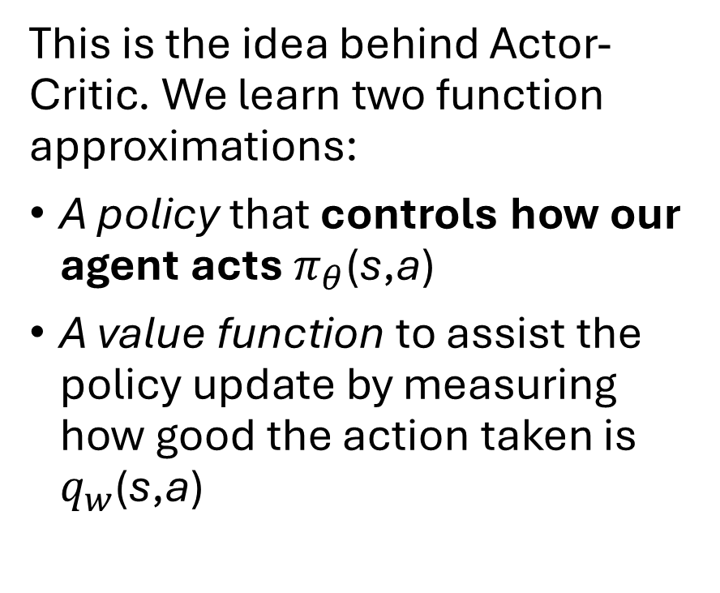
Reducing variance with Actor-Critic methods
This is the idea behind Actor-Critic. We learn two function approximations:
A policy that controls how our agent acts $π_{θ}\text{(}\text{s}\text{,}\text{a}\text{)}$
A value function to assist the policy update by measuring how good the action taken is $q_{w}\text{(}\text{s}\text{,}\text{a}\text{)}$​​

Slide 19
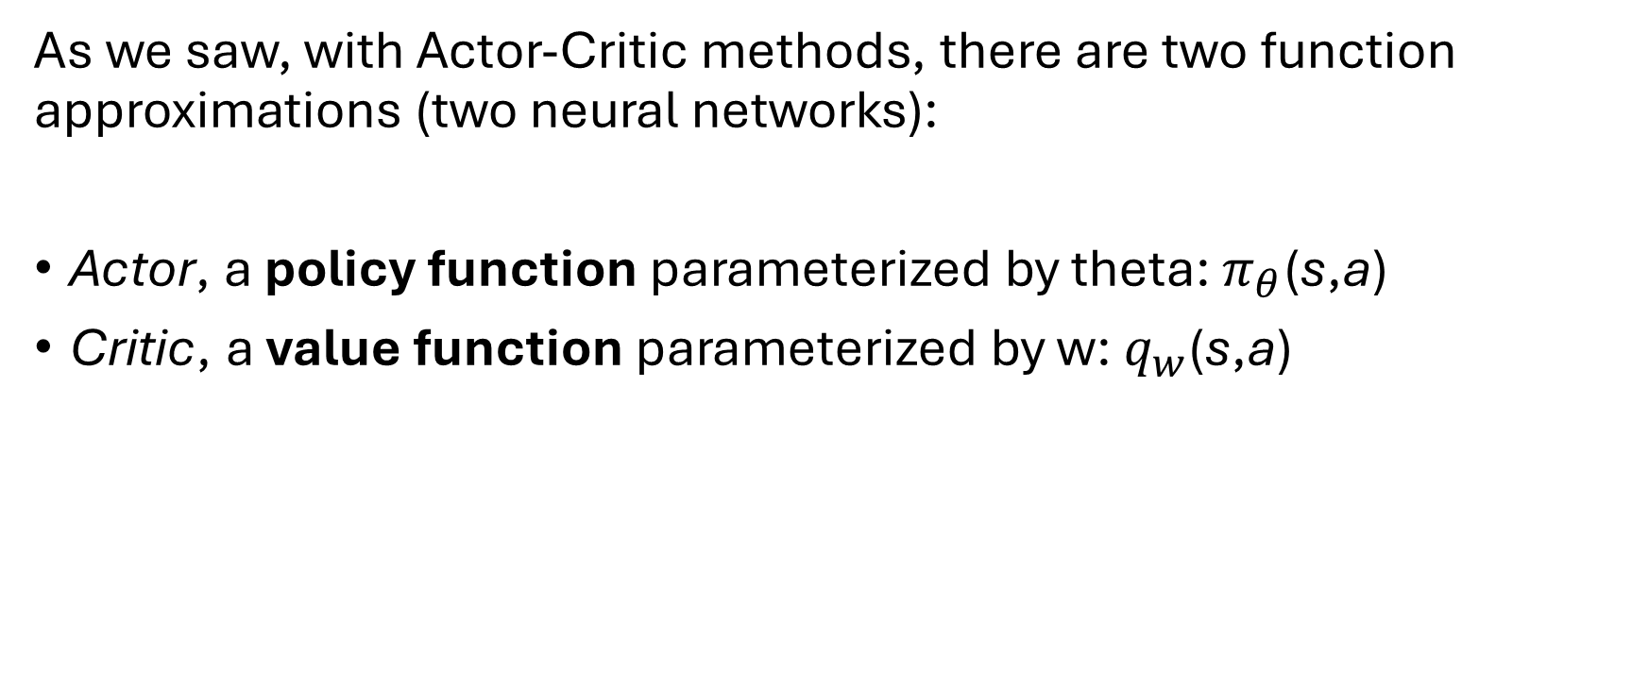
The Actor-Critic Process
As we saw, with Actor-Critic methods, there are two function approximations (two neural networks):
Actor, a policy function parameterized by theta: $π_{θ}\text{(}\text{s}\text{,}\text{a}\text{)}$
Critic, a value function parameterized by w: $q_{w}\text{(}\text{s}\text{,}\text{a}\text{)}$​​

Slide 20
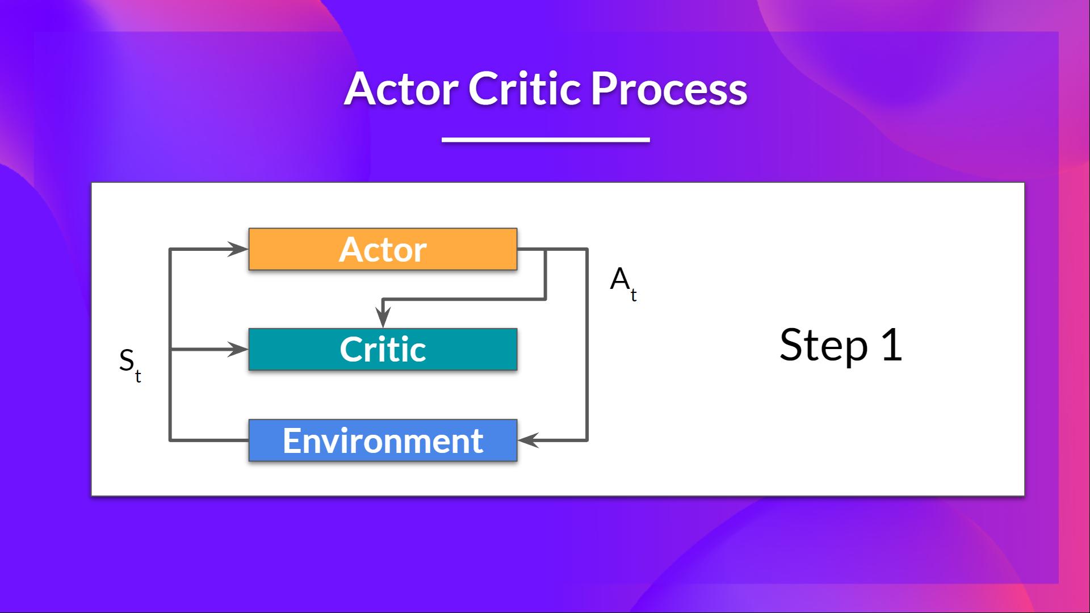

At each timestep, t, we get the current state $S_{t}$​ from the environment and pass it as input through our Actor and Critic.
Our Policy takes the state and outputs an action $A_{t}$​ ​

Slide 21
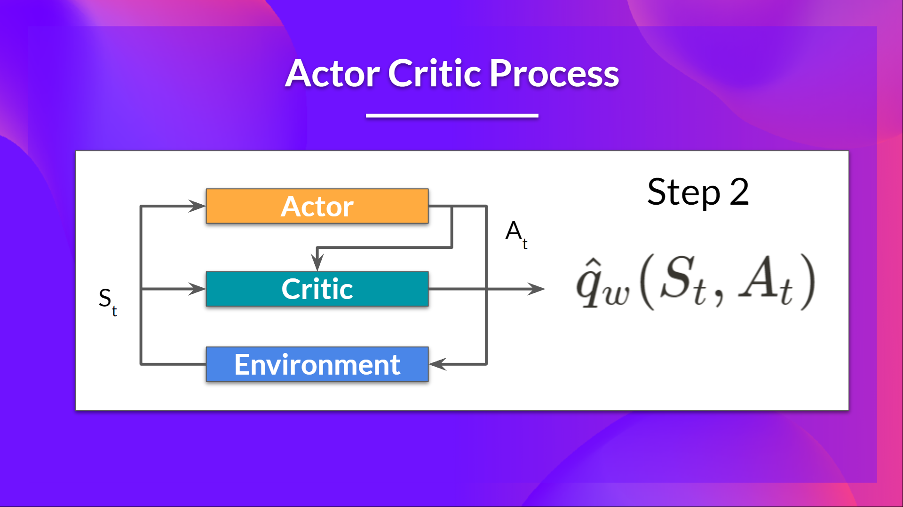
The Critic takes that action also as input and, using $S_{t}$​ ​and $A_{t}$​ ​, computes the value of taking that action at that state: the Q-value.

Slide 22
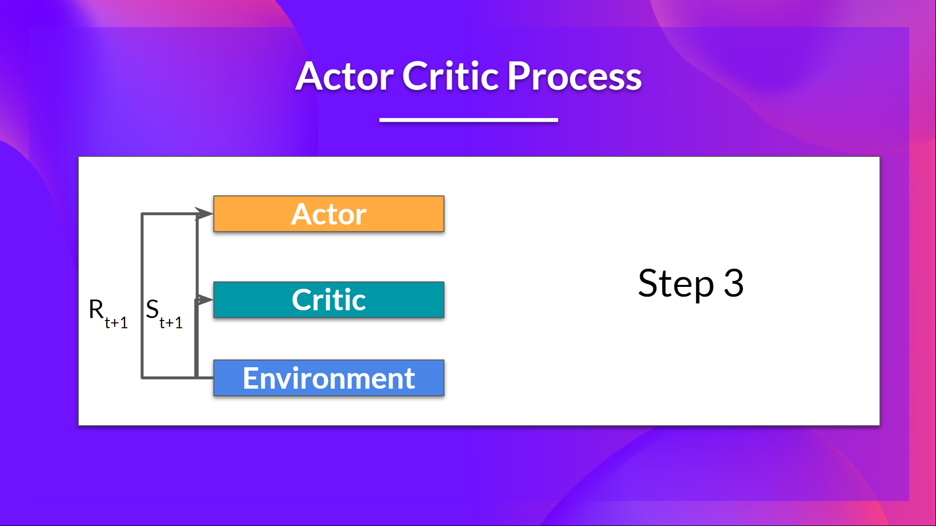
The action $A_{t}$​ performed in the environment outputs a new state $S_{t+1}$​ ​and a reward $R_{t+1}$​ ​

Slide 23
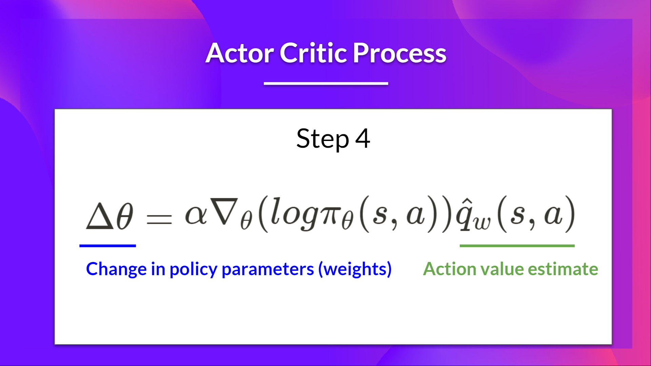
The Actor updates its policy parameters using the Q value.

Slide 24
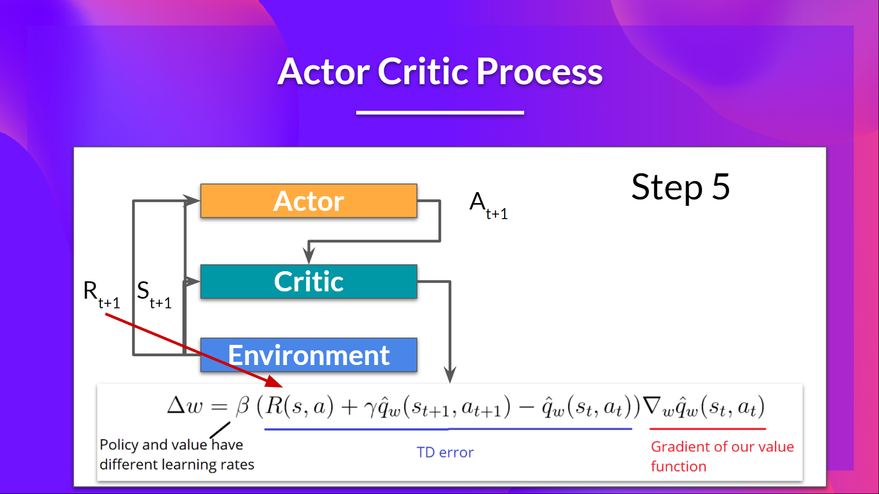
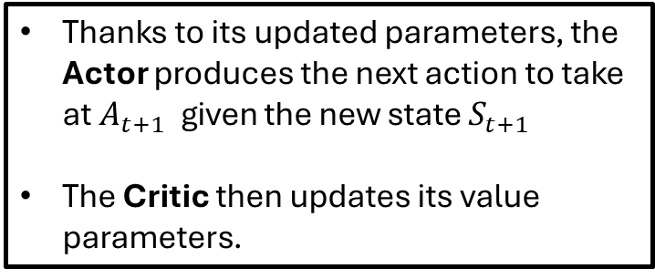
Thanks to its updated parameters, the Actor produces the next action to take at $A_{t+1}$​ given the new state $S_{t+1}$​
The Critic then updates its value parameters.

Slide 25
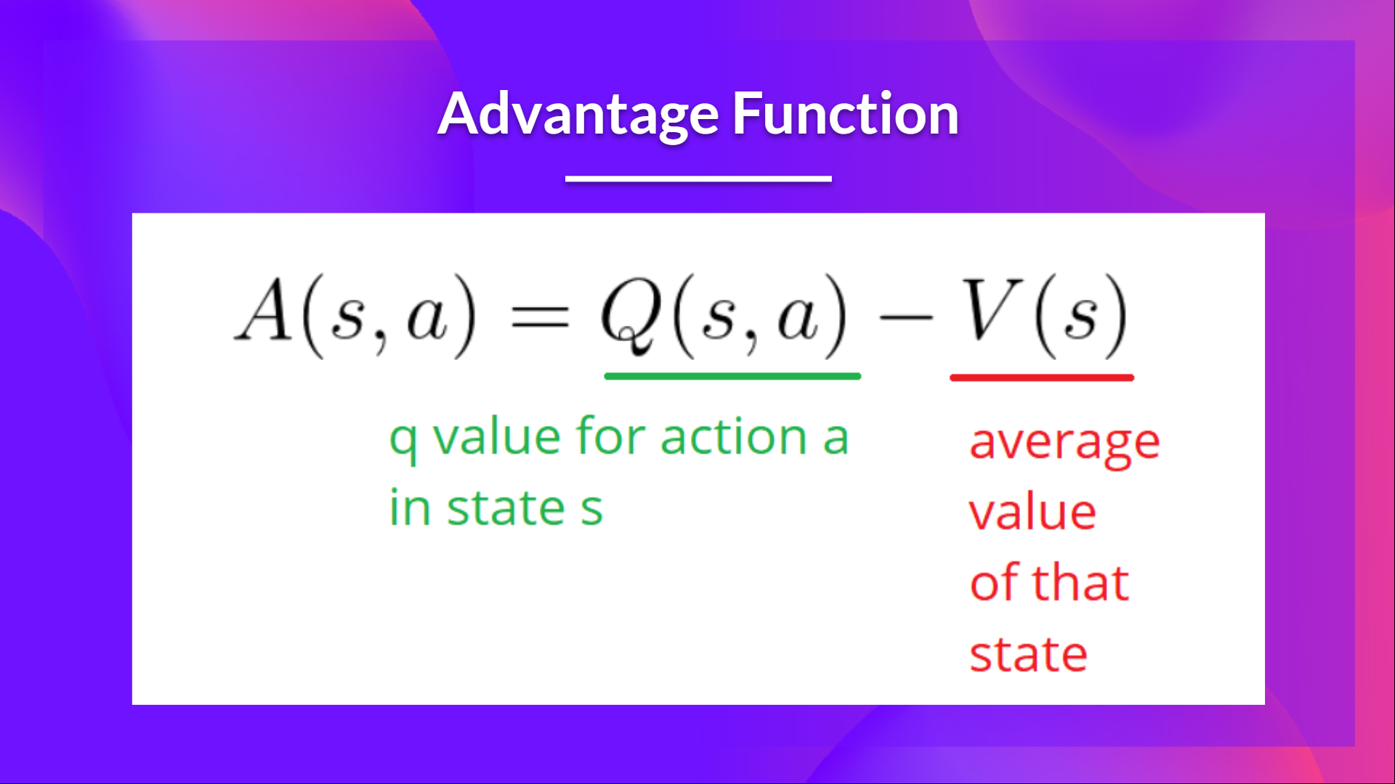
Adding Advantage in Actor-Critic (A2C)
We can stabilize learning further by using the Advantage function as Critic instead of the Action value function.

Slide 26
Adding Advantage in Actor-Critic (A2C)
The idea is that the Advantage function calculates the relative advantage of an action compared to the others possible at a state: how taking that action at a state is better compared to the average value of the state.
It’s subtracting the mean value of the state from the state action pair:

Slide 27
Adding Advantage in Actor-Critic (A2C)
In other words, this function calculates the extra reward we get if we take this action at that state compared to the mean reward we get at that state.

Slide 28
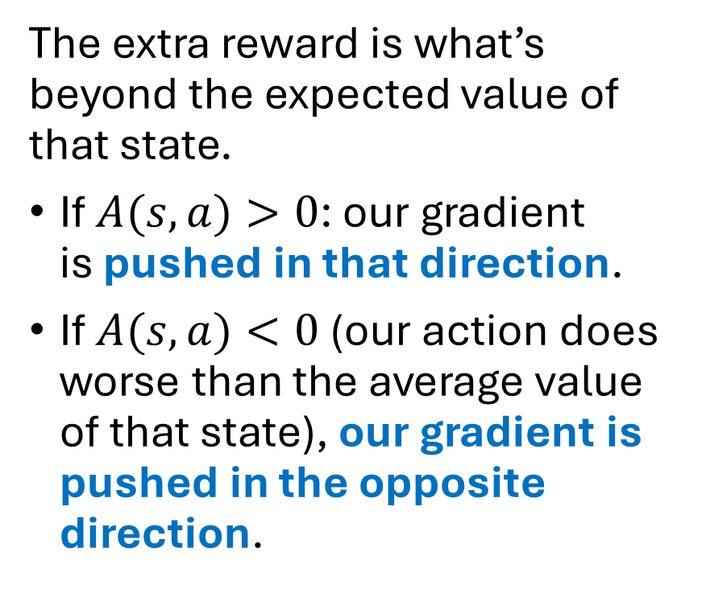
Adding Advantage in Actor-Critic (A2C)
The extra reward is what’s beyond the expected value of that state.
If $A(s,a)>0$: our gradient is pushed in that direction.
If $A(s,a)<0$(our action does worse than the average value of that state), our gradient is pushed in the opposite direction.

Slide 29
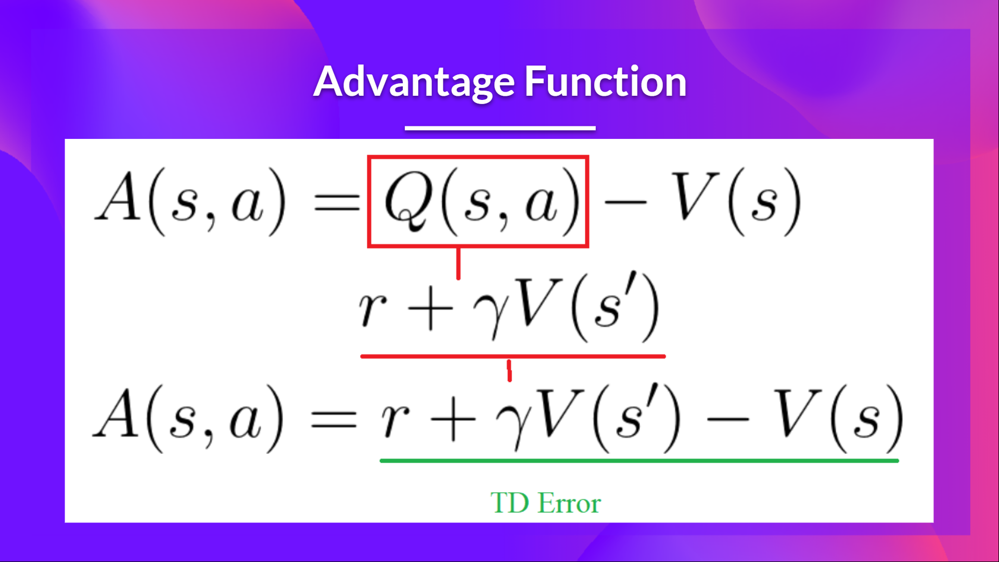
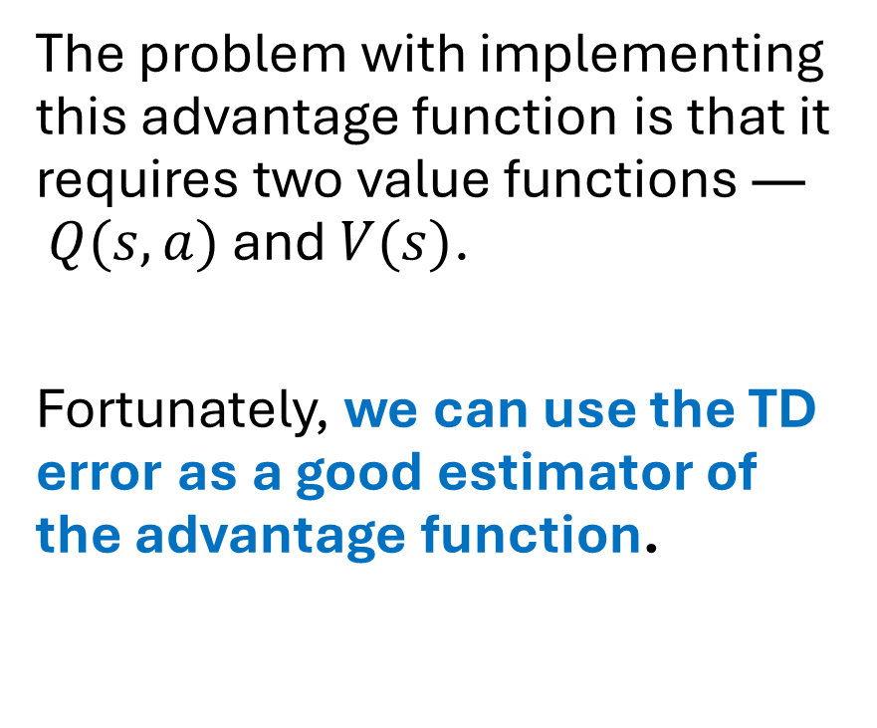
Adding Advantage in Actor-Critic (A2C)
The problem with implementing this advantage function is that it requires two value functions — $Q(s,a)$ and $V(s)$.
Fortunately, we can use the TD error as a good estimator of the advantage function.

